Slide 1
Stage One
Problem definition: delivering products through traffic to a specific location with the least cost.
Planning: our agent should find the best technique to reach the goal within the least cost.
The Environment: the traffic.
Agent type: delivery agent.

Slide 2
PEAS
Performance measure: time taken to reach the goal and the cost spent.
The Environment: the traffic.
- Actuators: wheels.
- Sensors:
1. GPS sensors: These sensors can track the delivery agent's location in real-time, allowing the delivery service to monitor progress and estimate delivery times accurately.
2. Motion sensors: These sensors can detect movement and vibration, which can be useful for detecting if a package has been dropped or mishandled.
3. Proximity sensors: These sensors can detect when the delivery agent is approaching an obstacle or when they are too close to the edge, which can help prevent accidents.
4. Ultrasonic sensors: These sensors use sound waves to detect obstacles in front of the delivery agent, which can help avoid collisions.
5. Camera.

Slide 3
Stage Two

Slide 4
up
Initial state
C
C
S
up
A
right
B
g
C
B
g
left
left
C
right
down
down
up
up
down
C
C
S
A
S
A
down
right
C
g
left
B
goal state
left
C
right

Slide 5
up
Initial state
C
C
S
up
A
right
B
g
C
B
g
left
left
C
right
successor function
The successor is from initial state(S) to the street A based on the weight of traffic .
Planning
The planning is to reach goal(G) from specific place by choosing the street A which the weight is smaller than the street B

Slide 6
C
S
up
successor function
the successor is from the street A to the goal(G) which returns the agent added to the specified square of goal .
Planning
The planning is to reach goal from the street A which we reach by the best way . . So by planning we directed the agent to reach the goal by the initial state to goal state
B
g
C
right
down
up
C
S
A
down
B
goal state
C
right

Slide 7
up
Initial state
C
successor function
the successor is from initial state(S) to the street B based on the weight of traffic .
Planning
The planning is to reach goal(G) from the street B which we reach by the best way
A
C
B
g
left
up
down
down
C
S
A
C
g
left

Slide 8
Successor function
the successor is from the street B to the goal(G) which returns the agent added to the specified square of goal .
Planning
The planning is to reach goal(G) from the street A which we reach by the best way . So by planning we directed the agent to reach the goal by the initial state to goal state
down
C
C
down
S
A
S
A
right
C
g
B
left
goal state
left
C
right

Slide 9
Initial state
C
C
S
A
5
Goal test :
In this case we choose the case A with the least weight to reach the goal
B
g
C
B
g
5
C
6
6
3
3
C
C
S
A
S
A
4
g
4
C
B
goal state
C

Slide 10
Initial state
C
C
S
A
7
Goal test :
In this case we choose the case B with the least weight to reach the goal
B
g
C
B
g
7
C
4
4
3
3
C
C
S
A
S
A
3
g
3
C
B
goal state
C

Slide 11
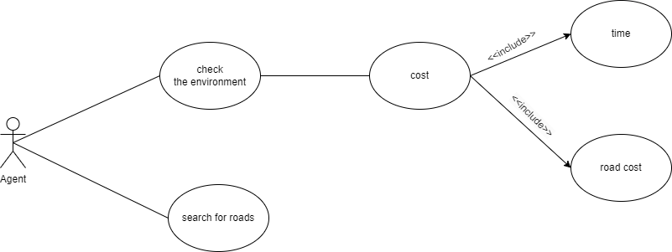
-The transition model is the whole steps to get the goal which is case A or B to have the optimal solution to reach its destination.
-Use case Diagram

